Slide 1
Global Wheat Detection
Patrick Di Rita, Ricardo Qiu, & Zekun Wu

Slide 2
Global Wheat Dataset
Our task is to detect wheat head using images
The dataset contains 3424 training data and 10 test data;
Each image has a resolution of 1024x1024 with labeled bounding boxes (x,y,h,w)
The evaluation metric is the mean average precision at different IoU (intersection over union): essentially sweep over different thresholds and compute their average

Slide 3
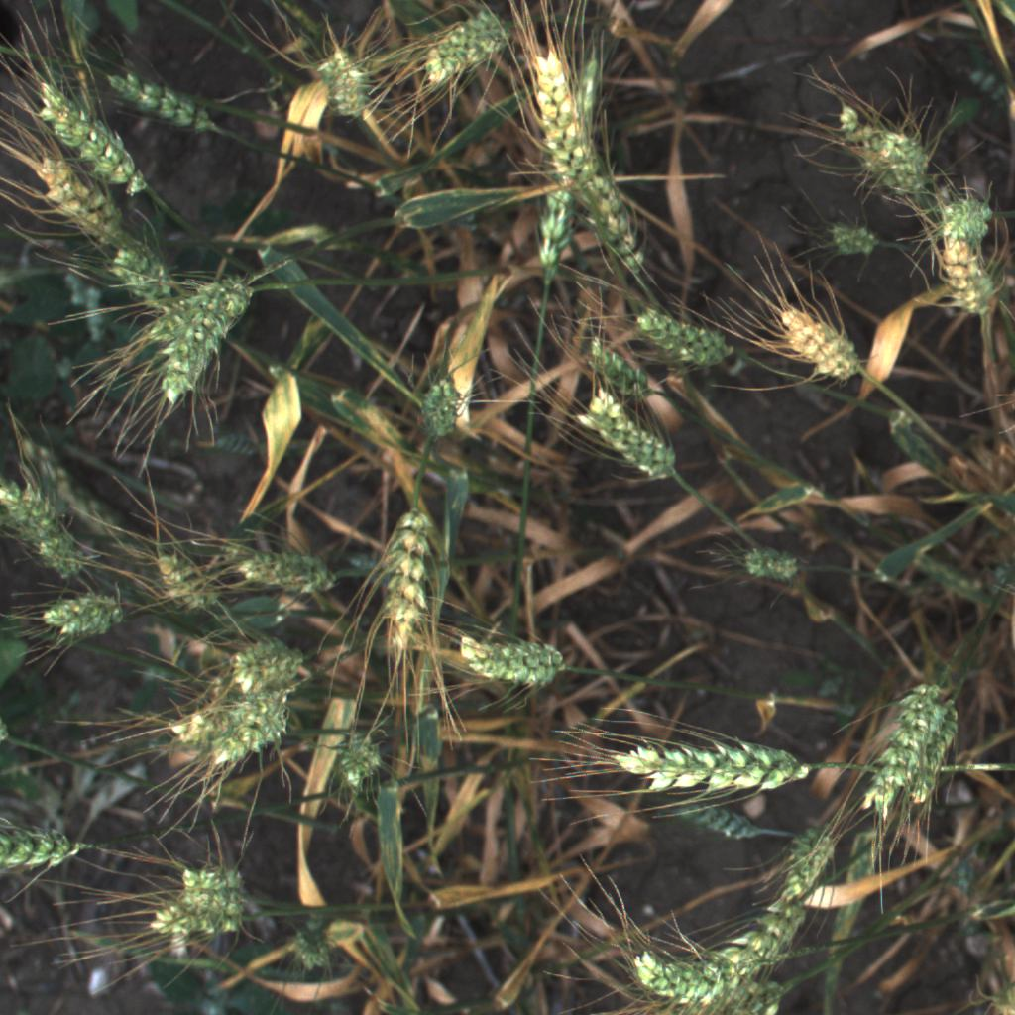
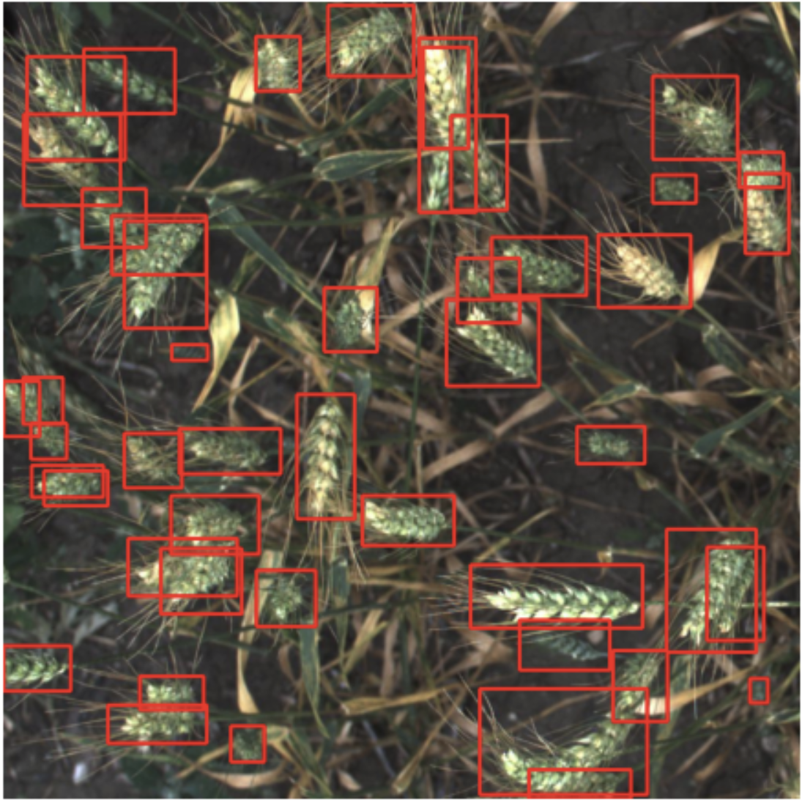
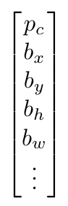
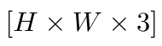
Background
Object Detection: Classification + Localization
Algorithm

Slide 4
Multiscale Sliding Windows detection
ConvNet
[0 or 1]
ConvNet
[0 or 1]
ConvNet
[0 or 1]
Super Computationally Expensive !!!
Especially when the stride is small

Slide 5
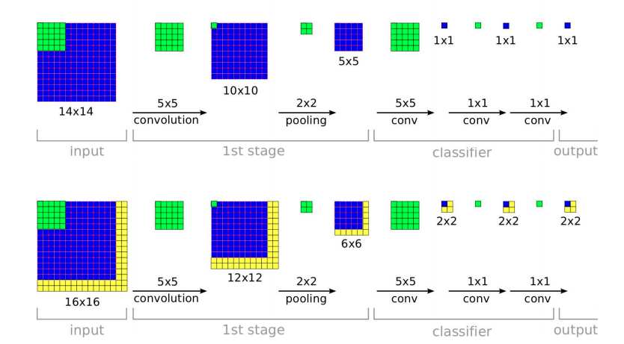
Implement this convolutionally
Stride = 2
[Sermanet et al., 2014, OverFeat: Integrated Recognition, Localization and Detection using Convolutional Networks]
Notes:
Drawbacks: using canonical bounding boxes, while sometimes, none of the bounding box can accurately bound the target object.

Slide 6
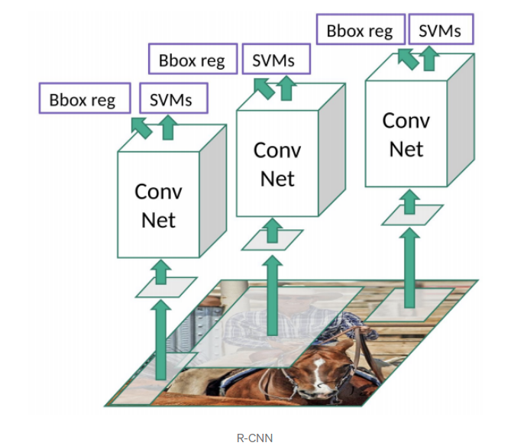
Region Proposal: R-CNN
Unlike Sliding windows method, they use proposed regions (2k) by selective search:
Generating initial sub-segmentation
Combine similar regions into a larger one
Feed into a ConvNet
Use SVM to classify proposed regions one at a time
[Girshick et al., 2013, Rich feature hierarchies for accurate object detection and semantic segmentation]

Slide 7
Faster Regional Proposal Methods
Fast R-CNN : Classify all the proposed regions at once by using convolutional implementation as we discussed. Essentially, feed the whole image along with its interested regions instead of just proposed regions to the network
Faster R-CNN: Use CNN to propose regions (We’ll see later)
[Girshick et al., 2015, Fast R-CNN]
[Ren et al., 2016, Faster R-CNN: Towards Real-Time Object Detection with Region Proposal Networks]

Slide 8
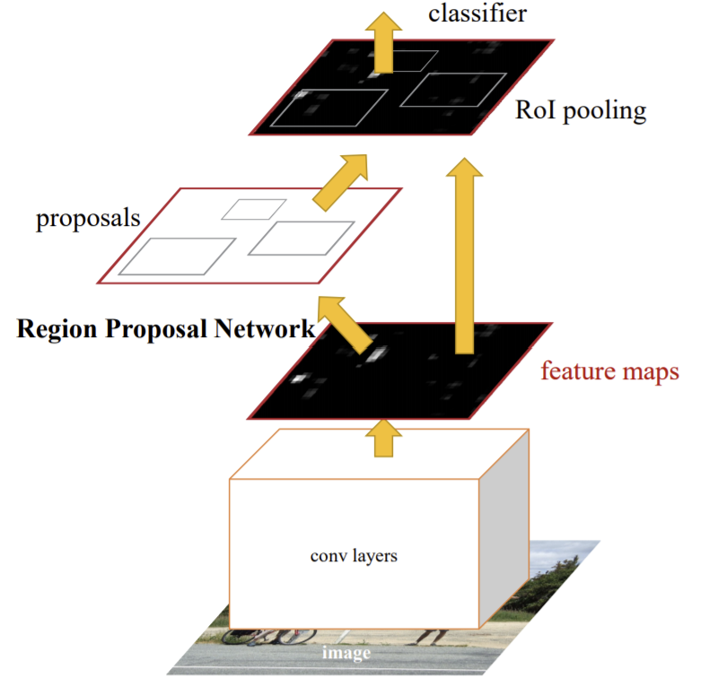
Faster R-CNN
Region Proposal Network (RPN) shares full-time convolutional features with Fast R-CNN detection network
Merged into a single network by sharing convolutional features
RPN component serves as ‘attention’ mechanism -- tells unified network where to look
https://arxiv.org/pdf/1506.01497.pdf

Slide 9
Faster R-CNN (cont.)
RPN takes in image and outputs set of rectangular object proposals, each with an ‘objectness’ score
Generated by sliding small network over convolutional feature map output by last shared convolutional layer
Fed into box-regression layer (reg) and box-classification layer (cls)
Multiple region proposals predicted at each sliding window location relative to translation invariant 'anchors’
Loss function optimized using SGD with momentum

Slide 10
Our Model
Used transfer learning on a Faster R-CNN instance with a ResNet-50-FPN backbone pretrained on the COCO dataset
Replaced pretrained model’s RPN box predictor with a new FastRCNNPredictor instance
Preformed Bayesian Optimization on SGD hyperparameters (learning rate, weight decay, momentum)
5 initialization trials using SOBOL sampler, 15 optimization trials using a Gaussian process with the Expected Improvement acquisition function
Maximized average validation IoU precision as a function of optimizer hyperparameters
Trained model for 30 epochs on entire training set using optimized hyperparameters

Slide 11
Results and Possible Improvements
Optimized SGD hyperparameters:
Learning Rate: 0.001; Weight Decay: 2.5429e-6; Momentum: 0.9
Kaggle submission scores:
Public Score: 0.6687; Private Score: 0.5721
Possible improvements are mostly data-related:
Generating synthetic training data through mosaic tiling
Pseudo-labeling
Implementing more complex image transforms

Slide 12
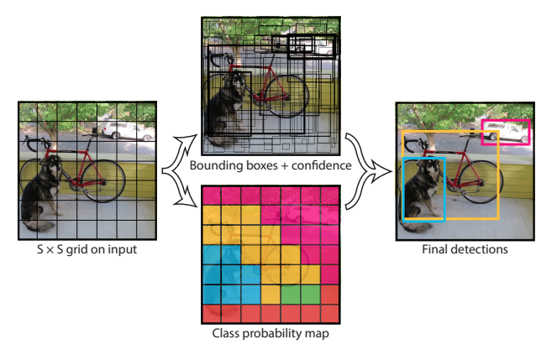
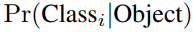
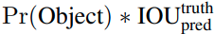
YOLO
Divide the whole image into an SxS grid (each grid predicts a conditional class distribution )
For each grid, there are B bounding boxes (including 4 coordinates + confidence score that it is a valid bounding box for any object: .)
During Inference,

Slide 13
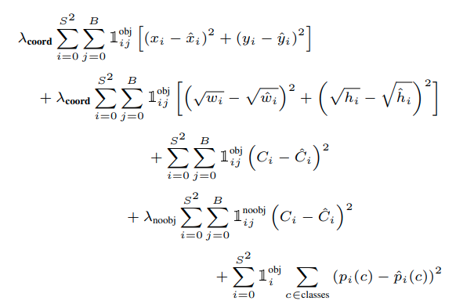
YOLO
Put all together:
The result of the final output is encoded as a SxSx(Bx5+C) tensor
While during implementation, anchor boxes are used. Then the final output of the network would be a SxSxAx(5+C) tensor, where A is the number of anchor boxes.
The whole network is implemented as an end-to-end ConvNet, trained with an unified squared loss
Also Note that, during inference, non-maximal suppression is used to postprocess multiple predictions into a single bounding boxes.
Notes:
Anchor boxes are used to predict multiple objects

Slide 14
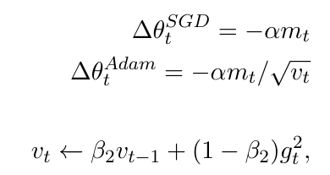
Our model
There are many versions of YOLO, (version 5 is up to date), but we use version 3 to demonstrate our idea
We used the same architecture as the original author with 333 layers with skip connection.
We used the weight pretrained on the COCO 2017 dataset to initialize our training, which is informed by the paper.
Still do a lot of data augmentation: adjust in HSV domain, image translation, random flip, and image mosaic
Train our model using SGD with momentum and Adam to compare their performance

Slide 15
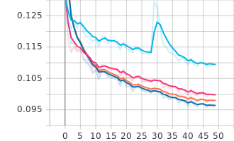
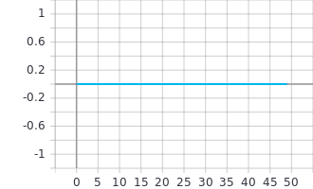
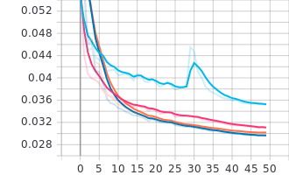
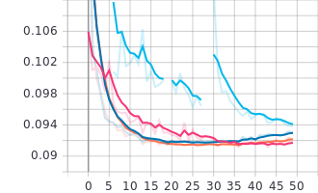
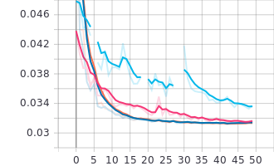
Results
Training
Validation
Objectness loss
classification loss
box loss
Notes:
The BLUE line denotes Adam with momentum equals to 0.935 and learning rate 0.0001; the PINK line denotes Adam optimizer with momentum 0.9 and learning rate 0.0001. the Orange line denotes SGD with momentum 0.9 and learning rate 0.001; The dark BLUE line denotes SGD with momentum 0.935 and learning rate 0.001

Slide 16
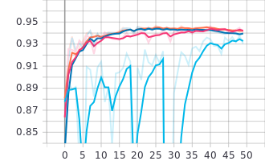
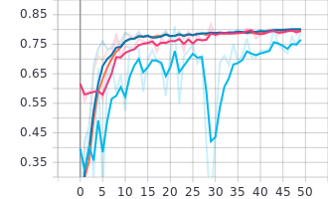
Training
Recall
Precision

Slide 17
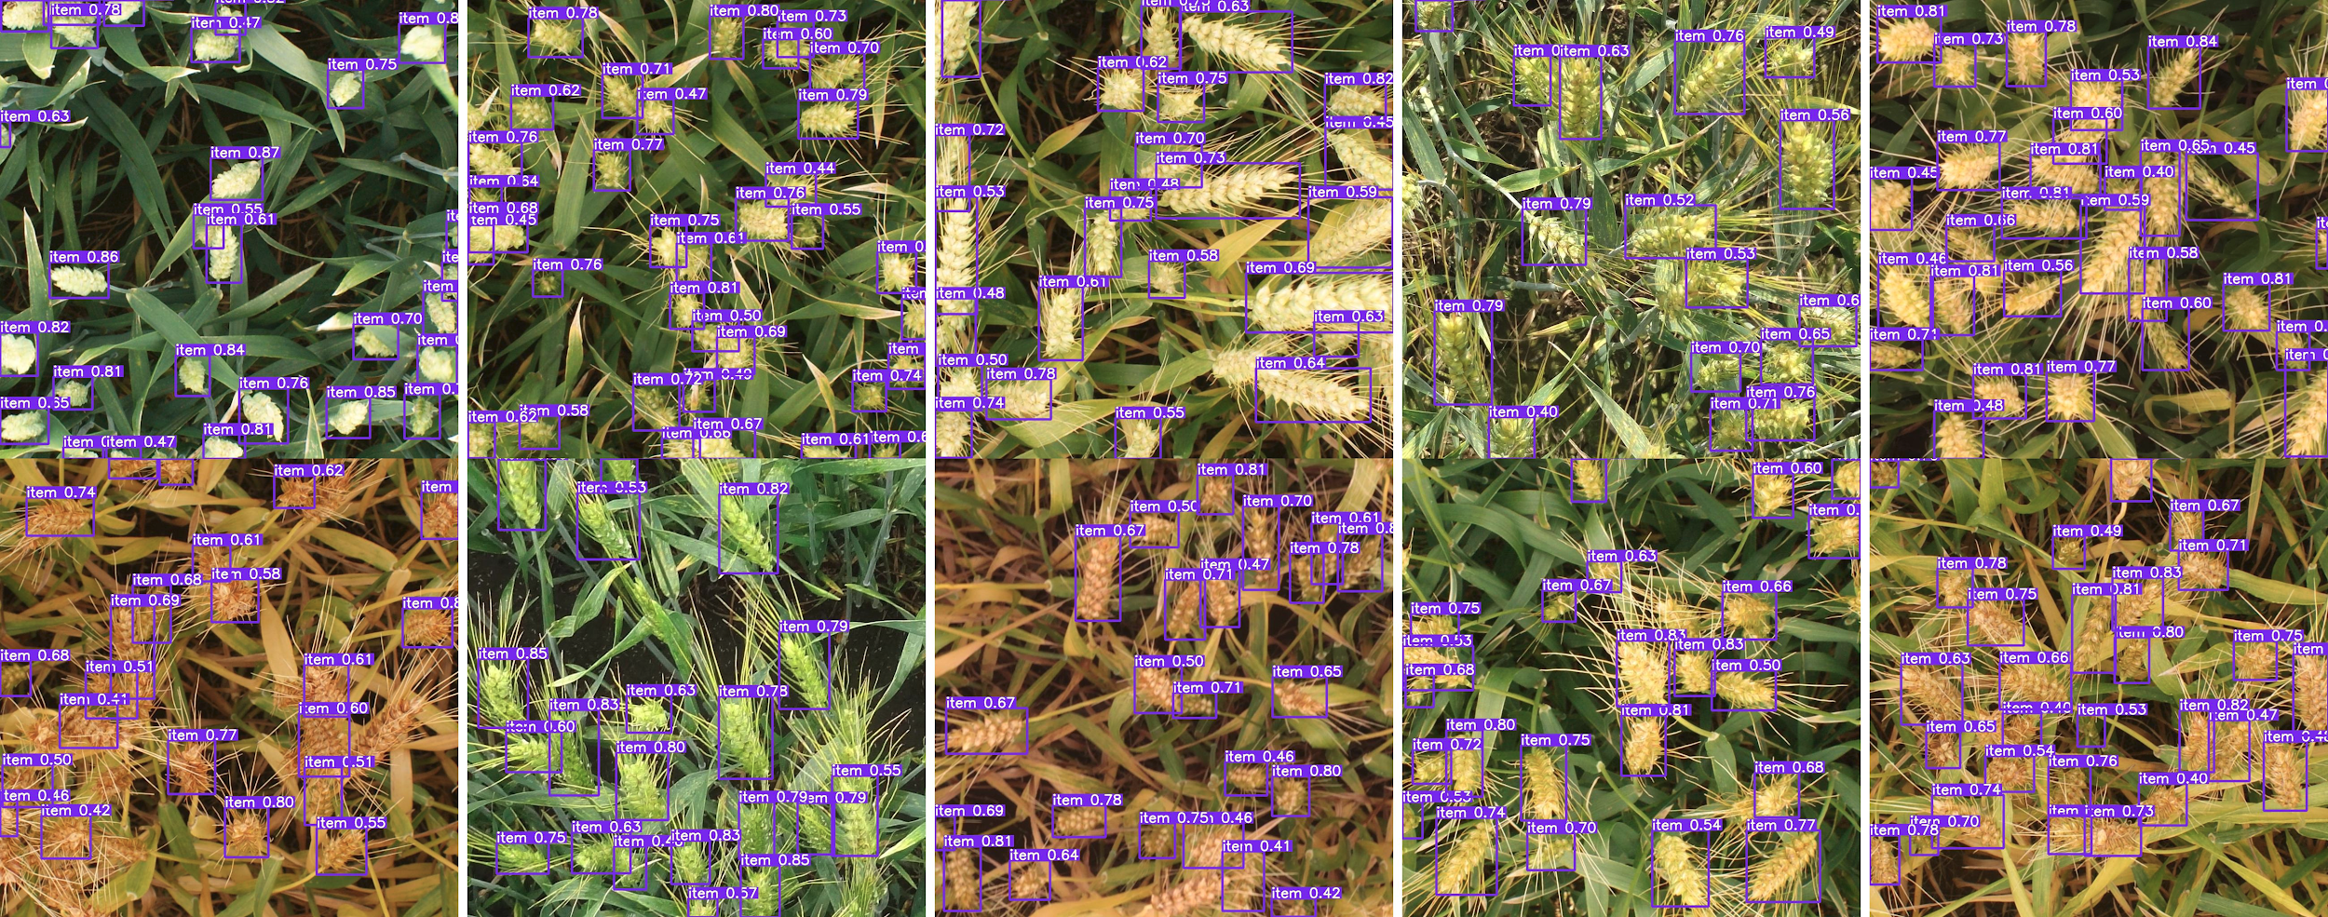
Inference YOLO
SGD with selected hyperparameters

Slide 18
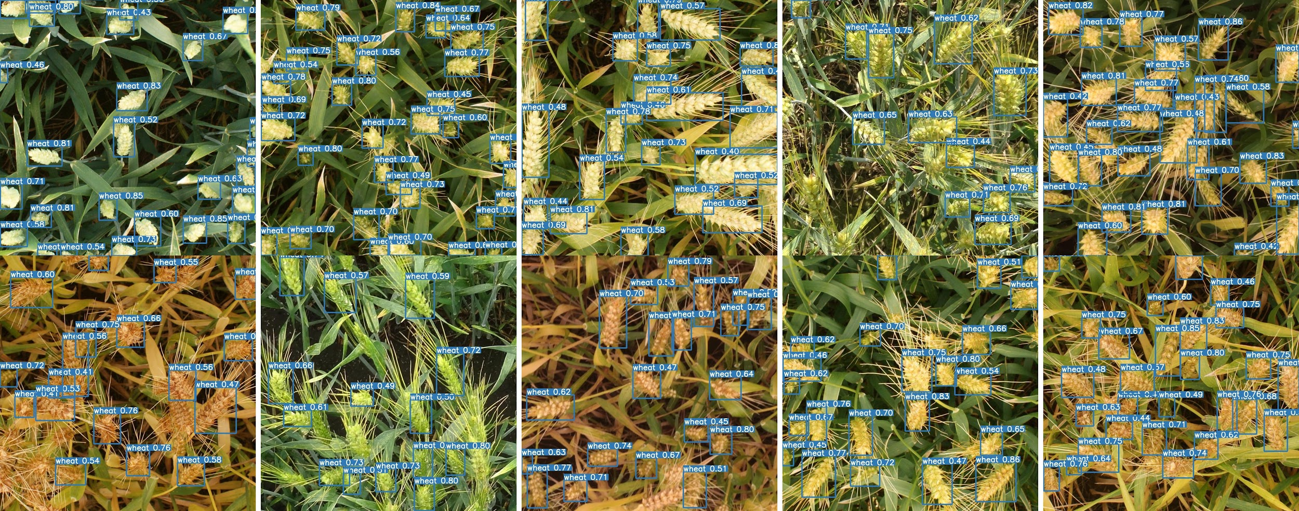
Inference YOLO
ADMM with selected hyperparameters

Slide 19
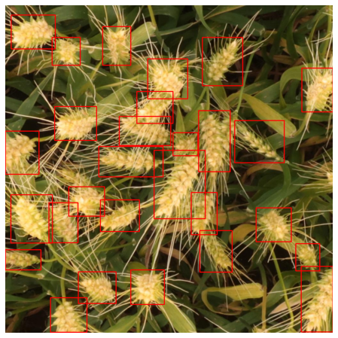
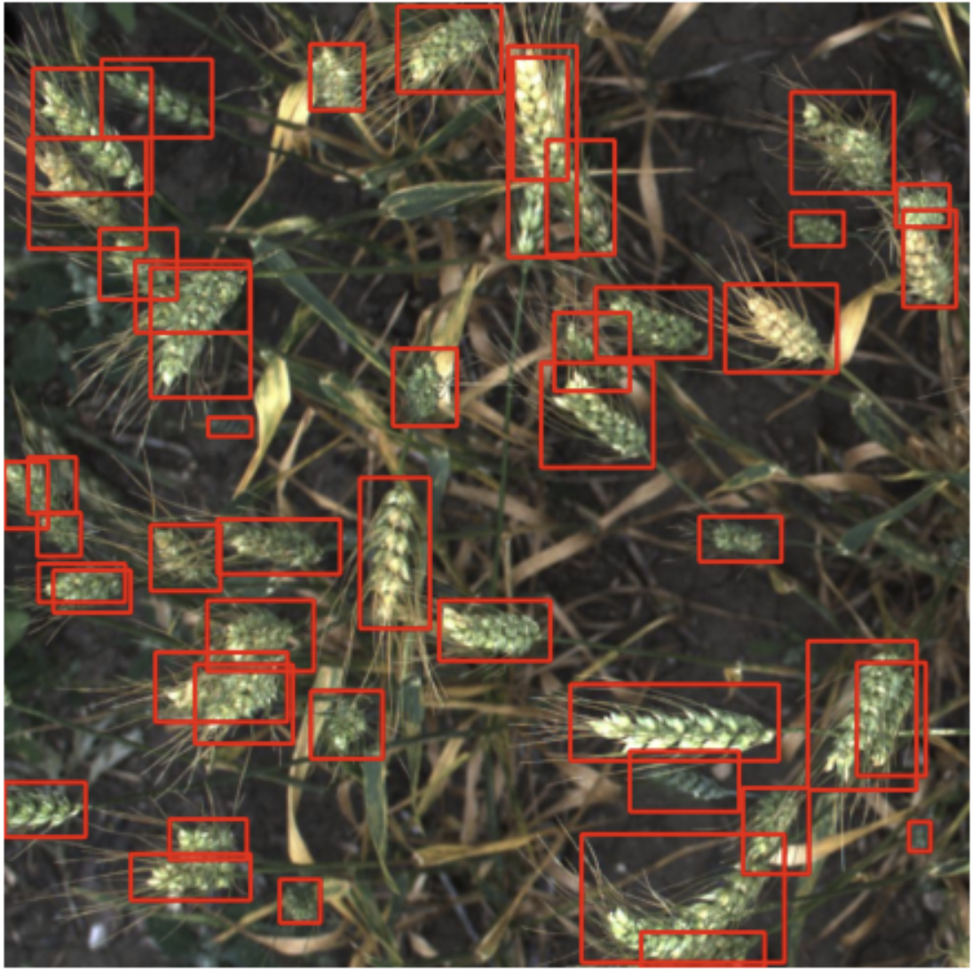
Inference (Faster-RCNN)
SGD with Bayesian Optimization Hyperparameters

Slide 20
Conclusion
In this project, we implemented and compared two state-of-the-art object detection algorithms: R-CNN-based method and YOLO;
The training and inference of YOLO is way faster than those of R-CNN-based methods, even the faster R-CNN, since YOLO uses an end-to-end lighter architecture than R-CNN-based methods;
Tested out two powerful optimizers in training neural network: SGD with momentum and Adam. The results indicate that SGD with momentum is slightly better during training in our implementation while the Adam is slightly better in terms of validation sometimes;
In terms of the inference precision, YOLO outperforms Faster R-CNN in our dataset with selected hyperparameters.

Slide 21
Insights
Although, in our dataset, the YOLO outperforms the Faster R-CNN in terms of precision, there original paper shows that the faster R-CNN generally has high precision in many datasets. Because, YOLO makes strong assumptions on number of bounding boxes and two bounding boxes of different objects will not have the same 'responsible' grid square.
The SGD with momentum also outperforms Adam in our task. Still, there is no leading evidence that which method outperforms the other in reality.
Also in our implementation, only limited combinations of hyperparameters are searched out, which might be another reason contributing to the above results.

